Slide 1

Cooper Dahlberg
David Sincyr
Ethan Esber
Kevin Finley
Michael Rumohr
Michael Taylor
Burger Breakout

Slide 2
Overview of Burger Breakout
MUR (4/26): Need to add to overview slide
(1-2 slides)
2D Side Scroller
Featuring running, jumping, fighting, and climbing
Escape the kitchen through various levels playing as a burger
Each level will have different types of obstacles
Throw food and drinks at enemies to help breakout
Watch out for boss fights!
Advance through the levels to unlock different items
Enjoy some catchy background music while playing
Retro pixel theme delivers a nostalgia overload
Hypnotic gameplay with mesmerizing visuals

Slide 3
Some Example User Stories
MUR (4/26): Need to add to overview slide
(1-2 slides)
As a player I want to be able to shoot food so that I can defeat my enemies.
The burger character will be able to shoot different types of food at enemies which complements the game theme and provides a unique game mechanic.
As a player I want to have a character that I can control so that I can move through the world.
The player’s character will be a hamburger that they can control with their inputs.
As a player I want my character to have animations so that the controls feel more realistic.
The character will have basic animations using sprite sheets to give a more realistic, yet retro feel to the game.

Slide 4
Important Functional & Non-Functional Requirements
MUR (4/26): Need to update slide.
(1-2 slides)
x

Slide 5
Important Use Cases
MUR (4/26): Need to update slide.
(2-3 slides)
x

Slide 6
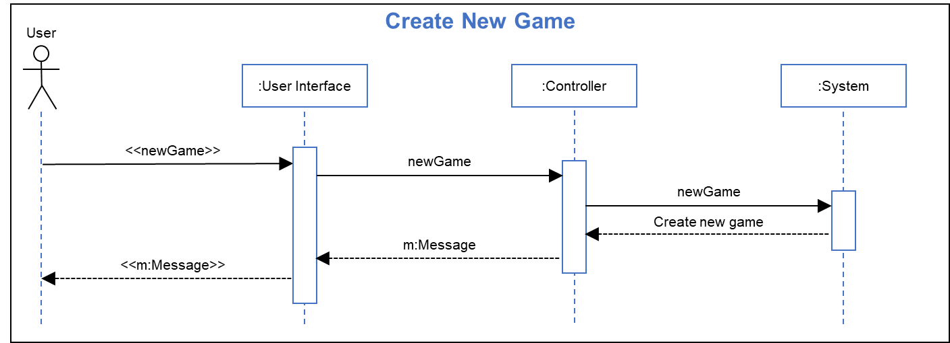
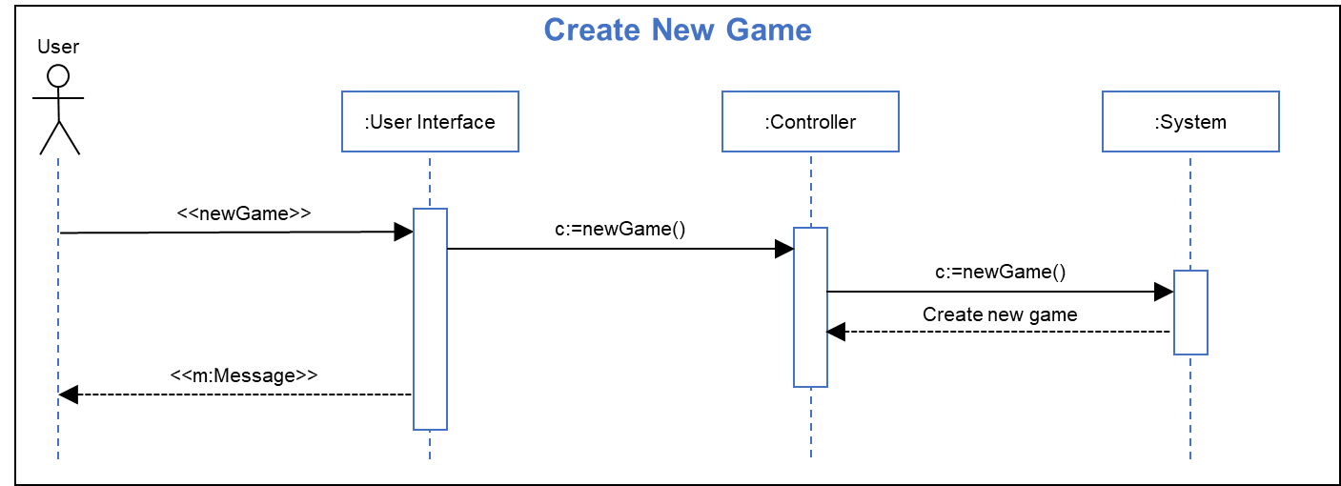
Important Sequence Diagrams: Create New Game
Analysis Sequence Diagram: Design Sequence Diagram:
Sequence Step Description:
Title: Create New Game
Actor(s): User
Precondition: User has selected “yes” at prompt to create new game
Outcome: A new game is started at the start of level one
User Actions System Actions
3. User clicks UI “yes” button 4.1. Game UI generates a new game message and sends it to the message controller
4.2 Message controller sends the new game call to the game controller
4.3 The game controller initializes a new game
5/6 The user interface displays the game view
MUR (4/26): Slides updated
(2-4 slides)

Slide 7
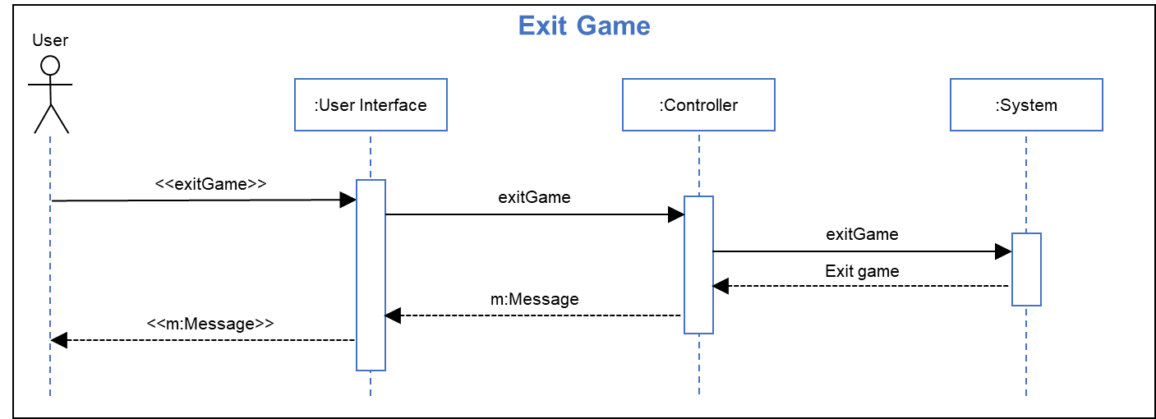

Important Sequence Diagrams: Exit Game
Analysis Sequence Diagram: Design Sequence Diagram:
Sequence Step Description:
Title: Exit Game
Actor(s): User
Precondition: User has selected “yes” at prompt to exit game
Outcome: The current game session is ended and the title screen is shown
User Actions System Actions
3. User clicks UI “yes” button 4.1. Game UI generates an exit message and sends it to the message controller
4.2 Message controller sends the exit game call to the game controller
4.3 The game controller ends the current game
5/6 The user interface displays the initial title screen
MUR (4/26): Slides updated
(2-4 slides)

Slide 8


Important Sequence Diagrams: Save Game
Analysis Sequence Diagram: Design Sequence Diagram:
Sequence Step Description:
Title: Save Game
Actor(s): User
Precondition: User has selected “yes” at prompt to save game
Outcome: The current game session state is saved and the game session is resumed
User Actions System Actions
3. User clicks UI “yes” button 4.1. Game UI generates a save game message and sends it to the message controller
4.2 Message controller sends the save game call to the game controller
4.3 The game controller saves the current game
5/6 The user interface return to the game view
MUR (4/26): Slides updated
(2-4 slides)

Slide 9
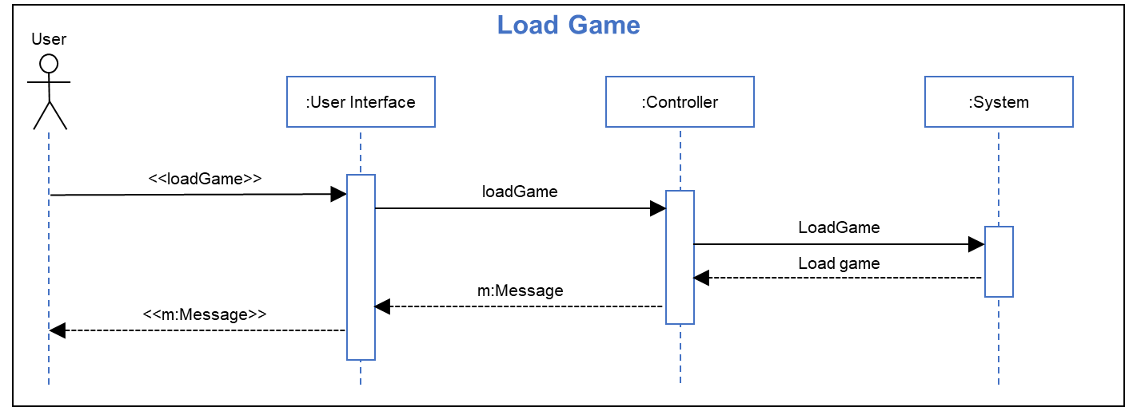
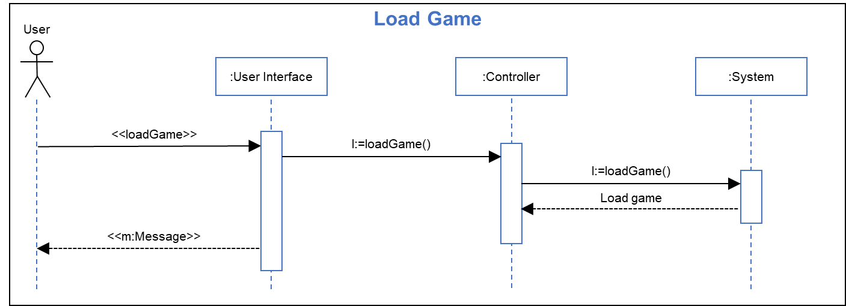
Important Sequence Diagrams: Load Game
Analysis Sequence Diagram: Design Sequence Diagram:
Sequence Step Description:
Title: Load Game
Actor(s): User
Precondition: User has selected “yes” at prompt to load game
Outcome: The current game session state is saved and the game session is resumed
User Actions System Actions
3. User clicks UI “yes” button 4.1. Game UI generates a load game message and sends it to the message controller
4.2 Message controller sends the load game call to the game controller
4.3 The game controller loads the game data previously saved
5/6 The user interface return to the game view
MUR (4/26): Slides updated
(2-4 slides)

Slide 10
Domain Model and Detailed Design Diagrams
MUR (4/26): Need to update slide.
(1-3 slides)
x

Slide 11
Architecture Design and Design Patterns Used
MUR (4/26): Need to update slide.
(2-3 slides)
x

Slide 12
Configuration Plans
MUR (4/26): Need to update slide.
(1-2 slides)
x

Slide 13
Summary of Test Plan, Test Cases and Results
MUR (4/26): Need to update slide.
(2-4 slides)
x

Slide 14
Results of Focus Group & Usability Study
MUR (4/26): Need to update slide.
(2-4 slides)
x

Slide 15
Security and Privacy Concerns Addressed
MUR (4/26): Need to update slide.
(2-4 slides)
x

Slide 16
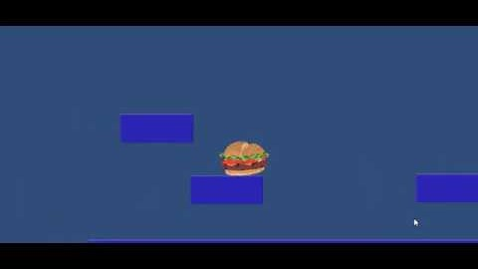
Mock-Up of Burger Breakout
MUR (4/26): Need to update slide.
(2-3 slides)
Still in the early development stage and will add the following features:
Mechanics
Enemies
Hazards
Scenery

Slide 17

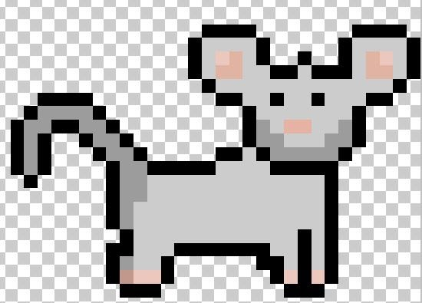
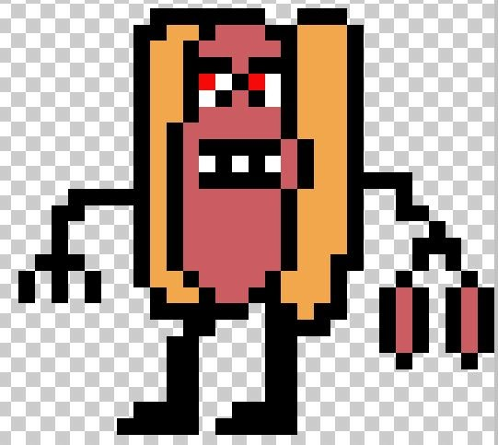
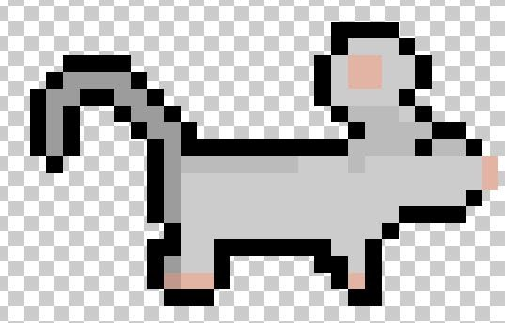
Early Concept Art: Characters
MUR (4/26): Kept character slides in case we want to reuse
Main Character – needs to be named
Mouse NPC
Hot Dawg Boss –Sausage link Nunchaku wielding

Slide 18



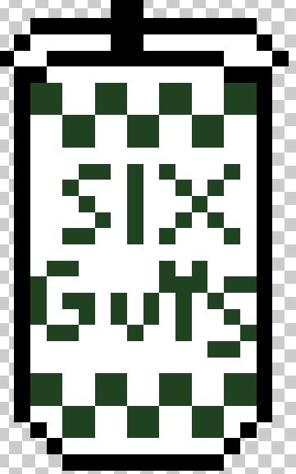
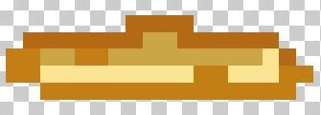
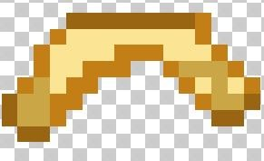
Early Concept Art: Throwable Items
MUR (4/26): Kept character slides in case we want to reuse
Lettuce
French Fries
Bottom: Fry-a-rang
Fountain Drink

Slide 19


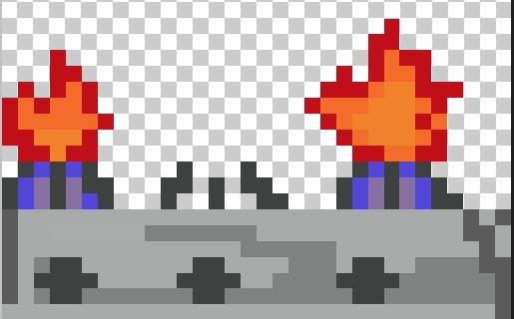

Early Concept Art: Hazards
MUR (4/26): Kept character slides in case we want to reuse
Dropped Food
Tomato Slices
Timed Jumps Across Kitchen Burners
Knives Being Used by Humans

Slide 20
Breakdown of Level of Effort for Team Members
MUR (4/26): “Who did what and the percentage. A summary of the product backlog can be used.”
(1-2 slides)
x

Slide 21
Work Left on Burger Breakout
MUR (4/26): Need to update slide.
(1-2 slides)
x

Slide 22
Link to Burger Breakout
MUR (4/26): “A link to downloadable application.”
(1 slide)
x

Slide 23

Questions/Comments/Complaints?

